Slide 1


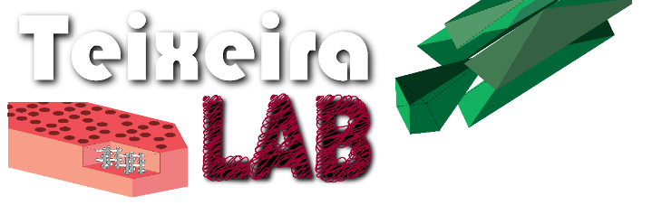

Fundamentals of Batch to Continuous Process Conversion in Specialty and API Chemistries
Andrew Teixeira, Robert Dempski
WPI Kickoff Meeting
May, 2020

Slide 2
Summer 2020 Plan
Teams:
Lab Team (red team): Andrew Teixeira (Prof.), Fatou Diop (PhD student), Emily Toala (Junior), Emily Gonzales (Junior)
AR Team (blue team): Robert Dempski (Prof.), Jennifer deWinter (Prof.), Karen Royer (PhD student), Laurie Mazza (MS student)
Summer Schedule: (if labs are open in parentheses)
Today -- Kickoff Meeting to introduce the team
May-June:
design lab experiments
write protocols
industry surveys
story board two modules
program AR modules
July-August:
purchase equipment
industrial interviews (in their labs).
(build modules)
(test protocols)
Integrate external content/videos
(integrate AR in lab)
(external feedback and iterating)

Slide 3

What is RAPID?
Rapid Advancement in Process Intensification Deployment (RAPID) Institute
$70 million, 5 year DOE center run by AIChE
Process Intensification (PI): novel process design and reaction engineering to improve processes (efficiency, yield, throughput, etc.).
RAPID’s PI Focus:
Advances in hardware and control strategies to combine multiple process steps into a single unit
Application of significantly enhanced driving forces — both chemical and physical — to drive chemical and transport processes.

Slide 4
Our Proposal
Title: Fundamentals of Batch to Continuous Process Conversion in Specialty and API Chemistries
Lead: Worcester Polytechnic Institute (WPI)
Partner: ACS GCI Pharmaceutical Roundtable
Supporting Organizations:
Zaiput Flow Technologies
CONTINUUS
On Demand Pharmaceuticals (ODP)
MettlerToledo
Total Funds: $175,000 (Federal) + $263,116 (Cost Share) = $438,116

Slide 5
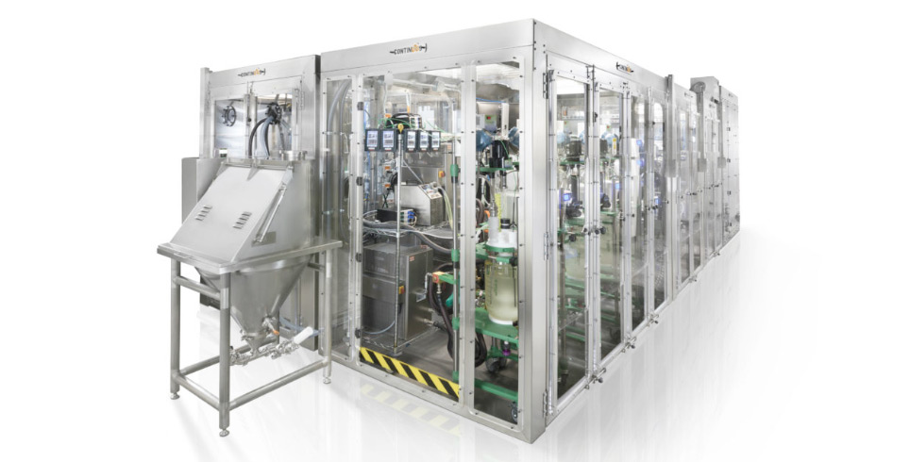
Goal Statement
This project aims to establish a state of the art continuous flow training facility and develop a hands-on laboratory course for process chemists, technicians and engineers.
The course targets the highly energy- and chemical-intensive small molecule pharmaceutical and specialty chemical industries that have traditionally relied heavily on less efficient, solvent-heavy batch chemistries.
This training will strategically target US domestic manufacturing of pharmaceutical and specialty compounds, while targeting substantial decreases in environmental emissions.
PI Concepts:
Modular system design
Continuous flow manufacturing
Rapid heating, cooling and mixing
Small manufacturing footprint and energy demand
photo source: CONTINUUS

Slide 6







Project Overview
Industry Stakeholders:
Defining the Problem
Flow Chemistry
Innovators
Technology Leaders
Educators/ Workforce Training
ChE
CH
IMGD
BETC
Approach:
Curriculum development with industrial partners
Lab test stands/modules for principles of flow chemistry
3-day hands-on lab course
Pilot Course:
25 trainees
3 days
March, 2021

Slide 7
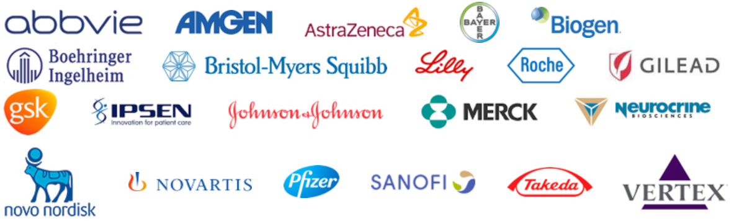
Team: WPI + ACS GCI Pharmaceutical Roundtable
Roles and Responsibilities
WPI: education content, lab construction, host pilot
ACS GCI Roundtable: develop case studies and iterate on curriculum
On Demand Pharmaceuticals: test stand for flow synthesis
CONTINUUS: test stands for unit operations
Zaiput: test stand for liquid-liquid extraction
MettlerToledo: test stand for process analytics
WPI Content Development:
Test stand development for undergraduate lab course
AR to be programmed in collaboration with IMGD program

Slide 8
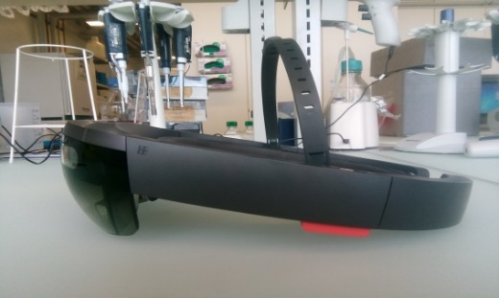
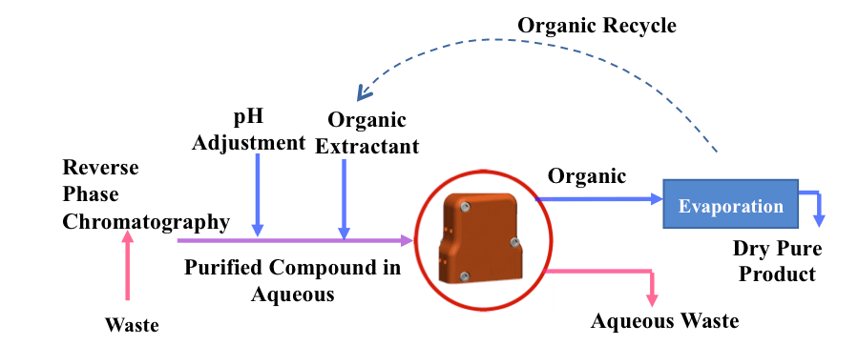
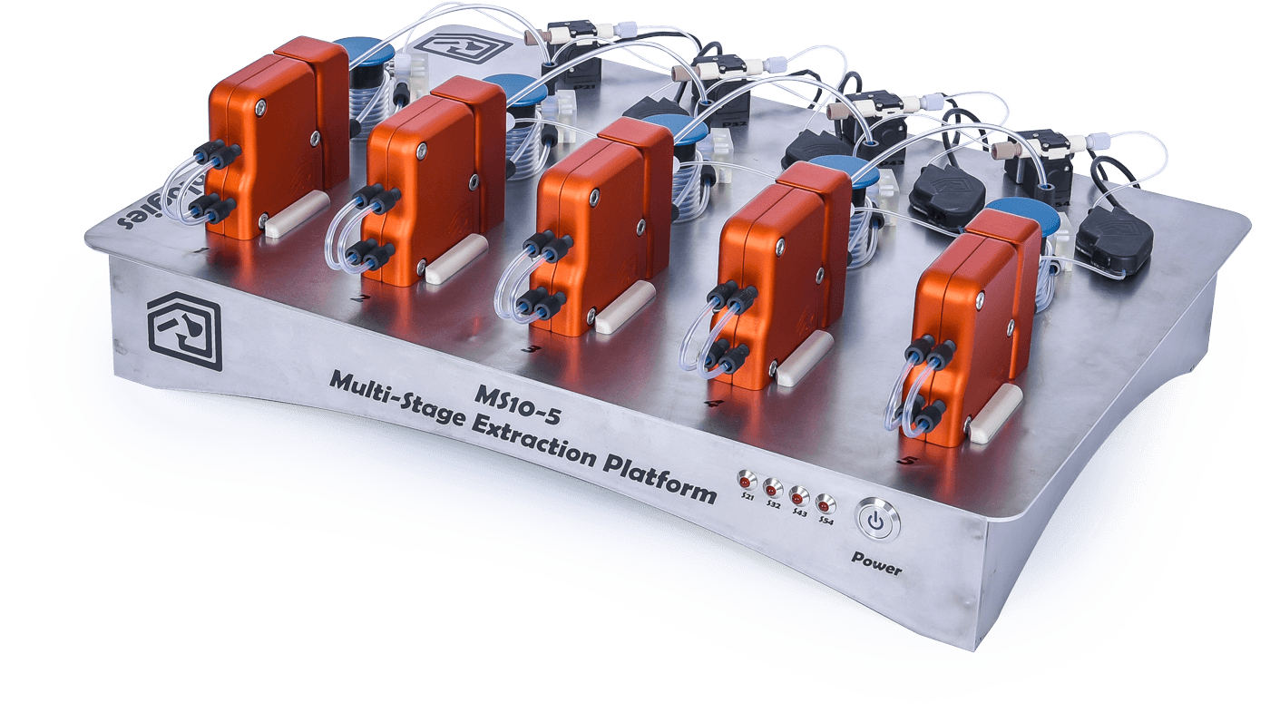
Course Development Plan/Timeline
Fall 2019: Finalize contracting
Spring 2020: Initial content development
Iterate on curriculum (RAPID, ACS GCI, WPI)
Augmented Reality: program 2 modules (e.g. separations + RTDs)
Summer 2020: Lab development
Construct 4-6 lab test stands
Develop lab write-ups
Record/aggregate/program expert content for AR
Fall 2020: Course Materials and Lab Testing
Formalize written/lecture materials and review (RAPID, ACS GCI)
Early 2021: Pilot Course + Evaluations
Pilot ~March 2021
Evaluations: AR interaction data, user surveys, partner surveys
source: Zaiput
CONCEPT
TEST STAND
AR Storyboard
Evaluations
Lab Modules
AR Program
Industry
Survey
Curriculum
SOPs + testing
Awarded
Contract
Pilot
2019
2020
2021

Slide 9
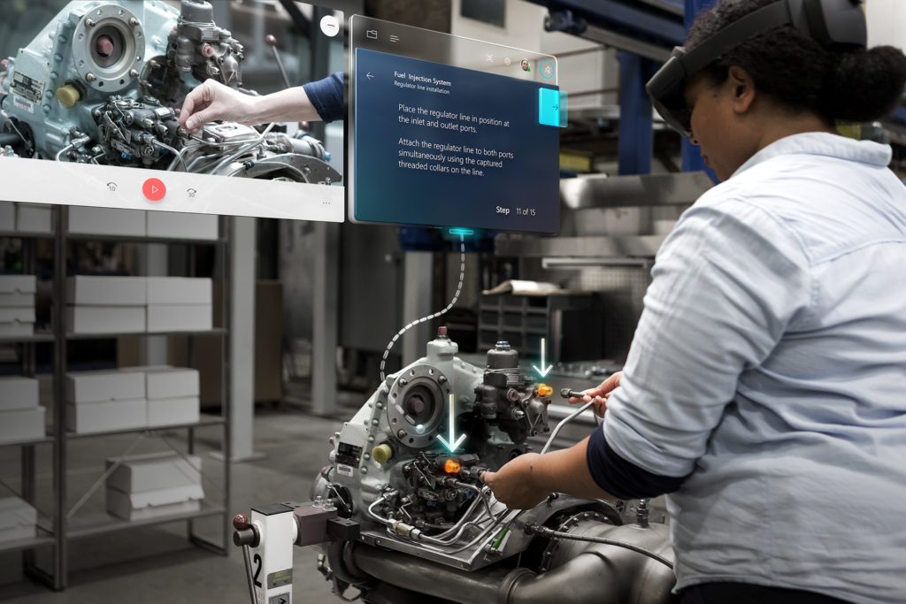
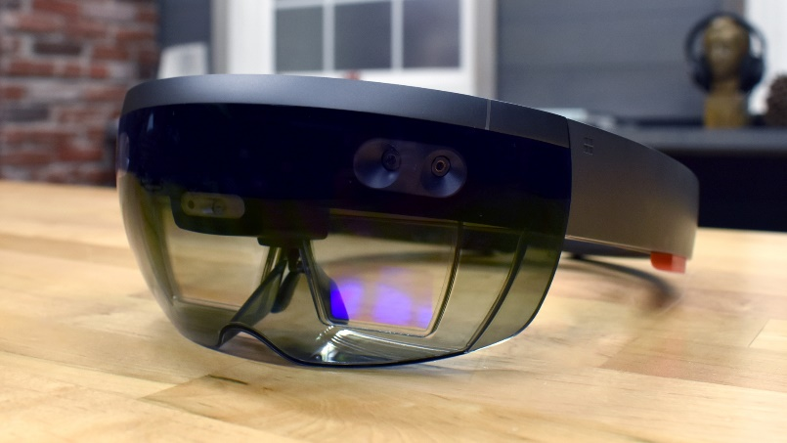
Augmented Reality
What is Augmented Reality?
Virtual reality transposes you into a completely virtual environment.
Augmented reality superimposes the virtual environment atop your actual environment, making it interactive.
Source: microsoft.com

Slide 10
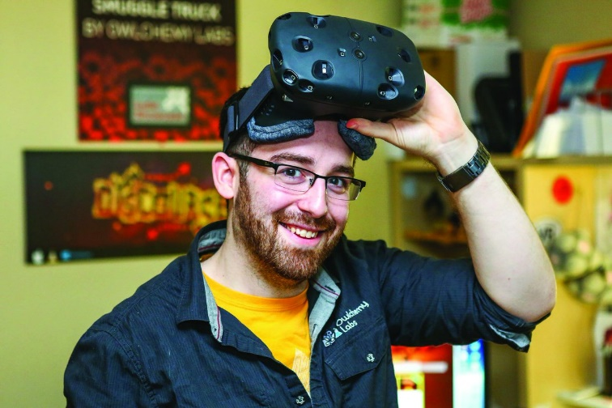
Augmented Reality
Why add AR to this grant?
Gives instructions/metadata with actual lab interactions
WPI is leader in Interactive Media and Game Development
Already implemented and published for chemistry labs
Archival form for expert training
Dempski et al., Increasing Enthusiasm and Enhancing Learning for Biochemistry-Laboratory Safety with an Augmented-Reality Program, J. Chem. Educ. 2018, 95, 10, 1747-1754

Slide 11
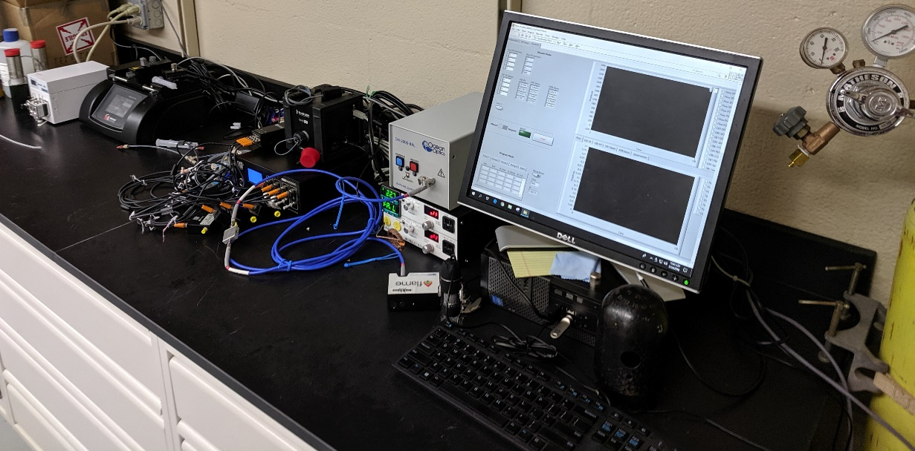
Inclusion in Undergraduate Education
Included in WPI CHE4401 (senior laboratory)
Lab Overview:
Design and construct a flow reactor from scratch that achieves target residence time and mixing conditions.
Test RTDs and acid/base reaction using several pumps, mixers, packed beds, pressure transducers and in-line UV-VIS.

Slide 12
Preliminary Curriculum Outline
Topic I: Introduction to Flow Chemistry
Introduction to fine chemical and pharmaceutical engineering
Overview of current state of the art in academic flow chemistry and industrial applications
Topic II: Small-Scale R&D and Microfluidics as a Tool
R&D: Classical and flow approaches for reaction screening and design of experiments
R&D: Automated + high throughput approaches for drug discovery
Topic III: Modular Flow Design
PI vs MCPI: Benefits of modular/swappable components and design considerations
Continuous flow basics: hardware, connections, pumps, major components
Unit operations: mixing, heating, cooling (static mixers, scalability)
Unit operations: continuous flow reactor design (plug flow, CSTR, PBR, photochemical)
Unit operations: continuous separations (phase separators, extractions, strippers)
Process analytical technology (PAT) and controls
Safety considerations in flow
Topic IV: Transition to Flow, Scalability and Scale-up
When is it efficient to move to flow? When is it not? Cost, safety, and sustainability.
Basics: scale-up by replication, scale-out, parallelization
PI: Preserving heat transfer, mass transfer, and mixing in flow
Design and safety considerations for pilot/production scale

Slide 13
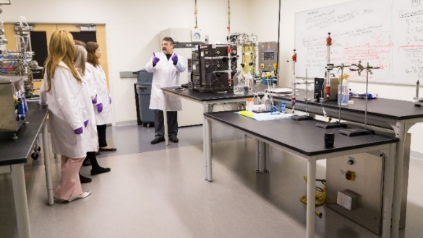
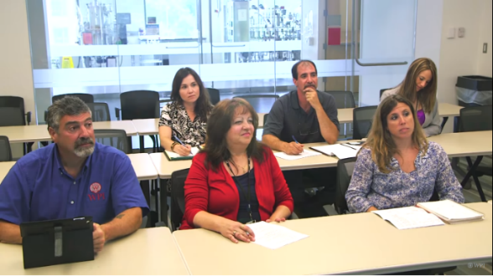
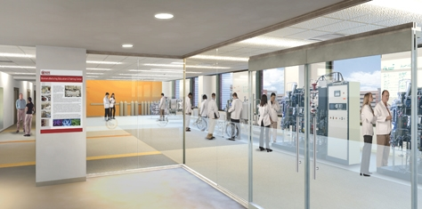
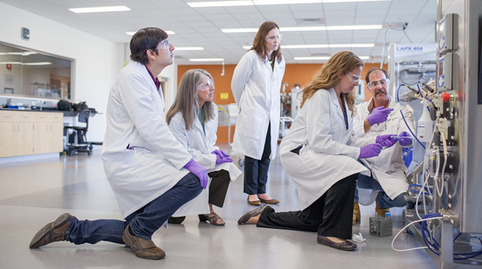
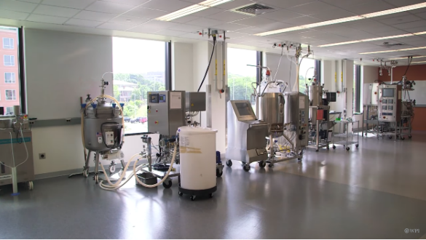
Facilities and Course Location
WPI Biomanufacturing Education & Teaching Center (BETC)
State-of-the-art 10,000 sq. ft. educational laboratory and pilot facility.
Opening in 2013, it has already trained over 1,300 participants from over 75 companies in GMP for biomanufacturing.
Video tour: http://wp.wpi.edu/betc/about-the-betc/

Slide 14
Pharmaceutical Roundtable
Surveys will be developed/circulated to:
Identify major pain-points/training gaps in flow chemistry
Identify specific unit operations where hands on training would most benefit the industry
Brainstorm case studies (chemistries) that would work well in 1-2 hour class modules
Additional Potential Involvement:
Provide expert content to assist in training where possible (e.g. recordings, designs, photos, etc.)
Example Modules:
Continuous separations (gas/liquid/solid)
Multiphase reactors (segmented, PBR)
Reactor sizing/RTDs
Scalable mixing/heating and characterization
Process analytics (P, T, UV, IR, etc.)

Slide 15



Questions?

Slide 16
Contractual Commitments
BP | Milestone or Go/No-Go # | Type | Description | Verification Method | Month
4 | 3.2.6.1.1 | Milestone | Industry surveys and curriculum | EWD committee endorsement | 39
4 | 3.2.6.1.2 | Milestone | Case studies and lab modules | Reviewed in RAPID quarterly report | 41
4 | 3.2.6.1.3 | GO/NO GO | Course curriculum | EWD committee endorsement | 45
4 | 3.2.6.2.1 | Milestone | Augmented reality storyboard | Reviewed in RAPID quarterly report | 40
4 | 3.2.6.3.1 | Milestone | Test stand designs | Reviewed in RAPID quarterly report | 43
4 | 3.2.6.3.2 | GO/NO GO | Test stands constructed | Reviewed in RAPID quarterly report | 43
4 | 3.2.6.4.1 | Milestone | Pilot event scheduled | Confirmed with RAPID EWD committee | 37
4 | 3.2.6.4.2 | Milestone | Event logistics scheduled | Confirmed with RAPID EWD committee | 47
5 | 3.2.6.1.4 | Milestone | Course materials developed | EWD committee review | 49
5 | 3.2.6.2.2 | Milestone | Augmented reality programmed and documented | Reviewed in RAPID quarterly report | 49
5 | 3.2.6.3.3 | Milestone | SOPs documented for lab test stands | Reviewed in RAPID quarterly report | 48
5 | 3.2.6.4.3 | GO/NO GO | Pilot course offered | Observed by RAPID EWD team | 50
5 | 3.2.6.4.4 | Milestone | Evaluations | Summarized in final report to RAPID EWD Committee | 51
BP4 = 2020
BP5 = 2021
Month 37 = 01/2020

Slide 17
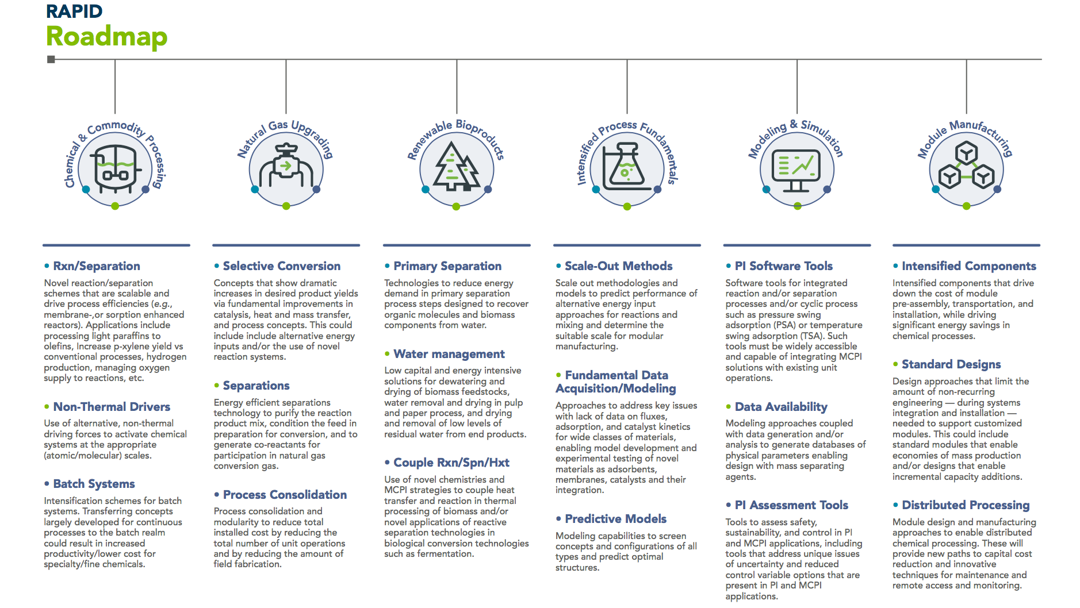
What is RAPID?
OUR WORK

